Slide 1
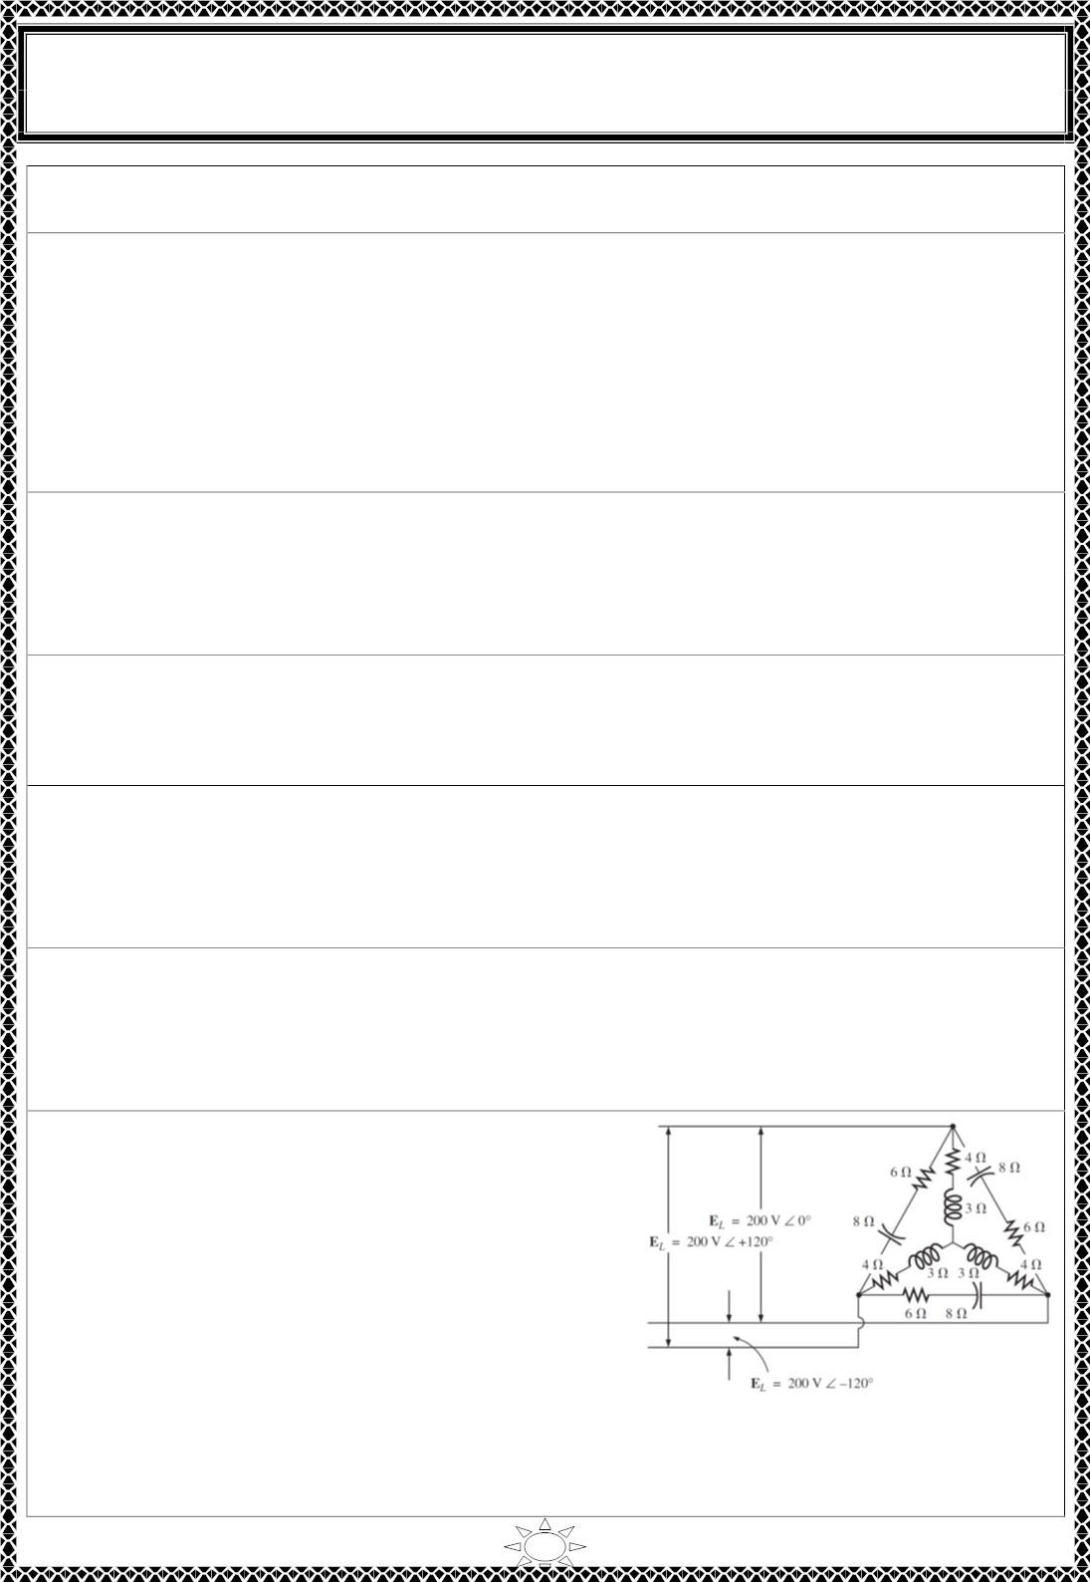
University of Diyala
Engineering College
Electronic Department
Electrical Circuits
2nd Class
Lecturer : Wisam N. AL-Obaidi
Year (2015-2016)
Ω. Find the line current, voltage and power factor at the source.
[Answer: : I = 128.1∠−ퟐퟐ ∙ ퟓퟑ A ,V = 249.83
a
ퟎ
an
∠−ퟑퟖ ∙ ퟑퟖ^{ퟎ}
A, pf = 0.912 lagging]
H.W.(18): A balanced three-phase source supplies power to three loads. The loads are
Load 1: 24 kVA at 0.6 pf lagging
Load 2: 10 kW at 0.75 pf lagging
Load 3: unknown
If the line voltage at the load is 208 V rms, the magnitude of the total complex power is
35.52 kVA, and the combined power factor at the load is 0.88 lagging, find the unknown
load.
ퟎ
[Answer: S = 13.09∠−ퟓퟖ ∙ ퟑퟗ kVA]
3
H.W.(19): Determine the complex power delivered to the three-phase load of a four-wire
Y- Y circuit. The phase voltages of the Y-connected source are V = 110∠0⁰ V rms, V =
an
bn
110∠-120⁰ V rms, and V = 110∠120⁰ V rms. The load impedances are Z = 50 + j80 Ω;
cn
A
Z = j50 Ω, and Z = 100 + j25 Ω.
B
C
[Answer: S = 68 + j109 VA, S = j242 VA, S = 114 + j128 VA, S = 182 + j379 VA]
A
B
C
T
H.W.(20): Determine the complex power delivered to the 3-phase load of a four-wire Y-Y
circuit. The phase voltages of the Y-connected source are V = 110∠0⁰ V, V = 110∠-
an
bn
Trail Version
Trail Version
Trail Version
Trail Version
Trail Version
Trail Version
Trail Version
Trail Version
Trail Version
Trail Version
Trail Version
Trail Version
Trail Version
120⁰ V, and V = 110∠120⁰ V. The load impedances are Z = Z = Z = 50 + j80 Ω.
cn
A
B
C
[Answer: S = S = S = 68 + j109 VA, S = 204 + j327 VA]
A
B
C
T
H.W.(21): Determine the complex power delivered to the three-phase load of a three-wire
Y- Y circuit. The phase voltages of the Y-connected source are V = 110∠0⁰ V rms, V =
an
bn
110∠-120⁰ V rms, and V = 110∠120⁰ V rms. The load impedances are Z = 50 + j80 Ω;
cn
A
Z = j50 Ω, and Z = 100 + j25 Ω.
B
C
[Answer: S = 146 + j234 VA, S = j94 VA, S = 141 + j35 VA, S = 287 + j364 VA]
A
B
C
T
H.W.(22): Determine the complex power delivered to the three-phase load of a three-wire
Y- Y circuit. The phase voltages of the Y-connected source are V = 110∠0⁰ V rms, V =
an
bn
110∠-120⁰ V rms, and V = 110∠120⁰ V rms. The load impedances are Z = Z = Z = 50
+ j80 Ω.
cn
A
B
C
[Answer: S = S = S = 68 + j109 VA, S = 204 + j327 VA]
A
B
C
T
H.W.(23): For the ∆ −Y connected load in Figure
shown. Find the total active, reactive and apparent
power, also find the load power factor.
[Answer: PT∆ = 7200 W, Q
= 9600 VAR (capacitve), S
= 12000 VA, PTY
T∆
T∆
=
6414.41 W, Q = 4810.81 VAR (inductive), S = 8045.76 VA, P = 13614.41 W, Q
TY
TY
T
T
= 4789.19 VAR, S T = 14432.2 VA, cos흋 = 0.943 leading]
4

Slide 2
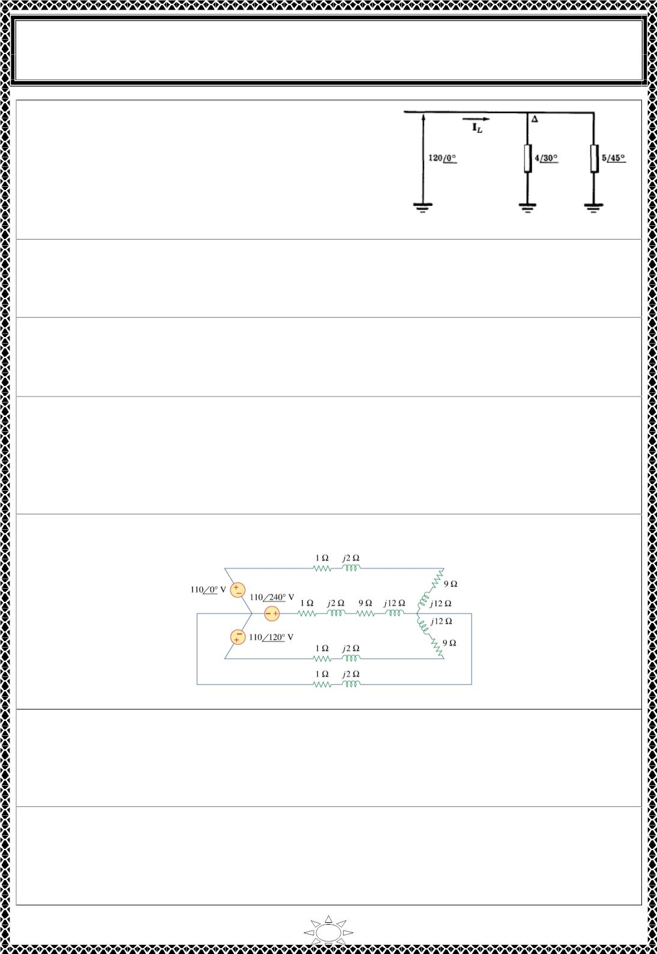
University of Diyala
Engineering College
Electronic Department
Electrical Circuits
2nd Class
Lecturer : Wisam N. AL-Obaidi
Year (2015-2016)
H.W.(24): Three identical impedances of 12∠ퟑퟎ^{ퟎ}
ohms in a ∆-connection and three identical
impedances of 15∠ퟒퟓ^{ퟎ} ohms in Y-connection are
both on the same three-phase, three-wire 208 V
system ABC system. Find the line currents and total
active power.
ퟎ
[Answer: I = 53.6∠−ퟑퟔ. ퟔ A, P = 15500 W]
L
H.W.(25): A three-phase source delivers 4800 VA to a wye-connected load with a phase
voltage of 208 V and a power factor of 0.9 lagging. Calculate the source line current and
the source line voltage.
[Answer: I = 7.69 A, V = 360.3 V]
L
L
H.W.(26): A balanced wye-connected load with a phase impedance of 10 – j16 Ω is
connected to a balanced three-phase generator with a line voltage of 220 V. Determine the
line current and the complex power absorbed by the load.
ퟎ
[Answer: I = 6.732 A, S = 2565∠−ퟓퟖ VA]
L
H.W.(27): A 4200-V, three-phase transmission line has an impedance of 4 + j10 Ω per
phase. If it supplies a load of 1 MVA at 0.75 power factor (lagging), find:
(a) the complex power
Trail Version
Trail Version
Trail Version
Trail Version
Trail Version
Trail Version
Trail Version
Trail Version
Trail Version
Trail Version
Trail Version
Trail Version
Trail Version
(b) the power loss in the line
(c) the voltage at the sending end
[Answer: S = 0.75 + j0.6614 MVA, P = 25.19 kW, V = 4.443∠−ퟐ ∙ ퟕퟎퟗ V]
L
ퟎ
H.W.(28): Given the circuit in Figure below, find the total complex power absorbed by
the load.
[Answer: S = 551.86 + j735.81 VA]
H.W.(29): A three-phase line has an impedance of 1 + j3 Ω per phase. The line feeds a
balanced delta-connected load, which absorbs a total complex power of 12 + j5 k VA. If
the line voltage at the load end has a magnitude of 240 V, calculate the magnitude of the
line voltage at the source end and the source power factor.
[Answer: V = 287.04 V, pf = 0.9451]
H.W.(30): A three-phase supply, with the line voltage 240 V rms positively phased, has an
unbalanced delta-connected load as shown in Figure. Find the phase currents and the total
complex power.
[Answer: I = 9.6∠ − ퟗퟎ A, I = 6∠ퟏퟐퟎ^{ퟎ}
AB
ퟎ
BC
A, ICA = 8∠ − ퟏퟓퟎퟎ A, SAB = j2304 VA,
S = 1440 VA, S = 1662.77 + j960 VA, S = 3102.77 + j3264 VA]
CA
BC
T
5

Slide 3
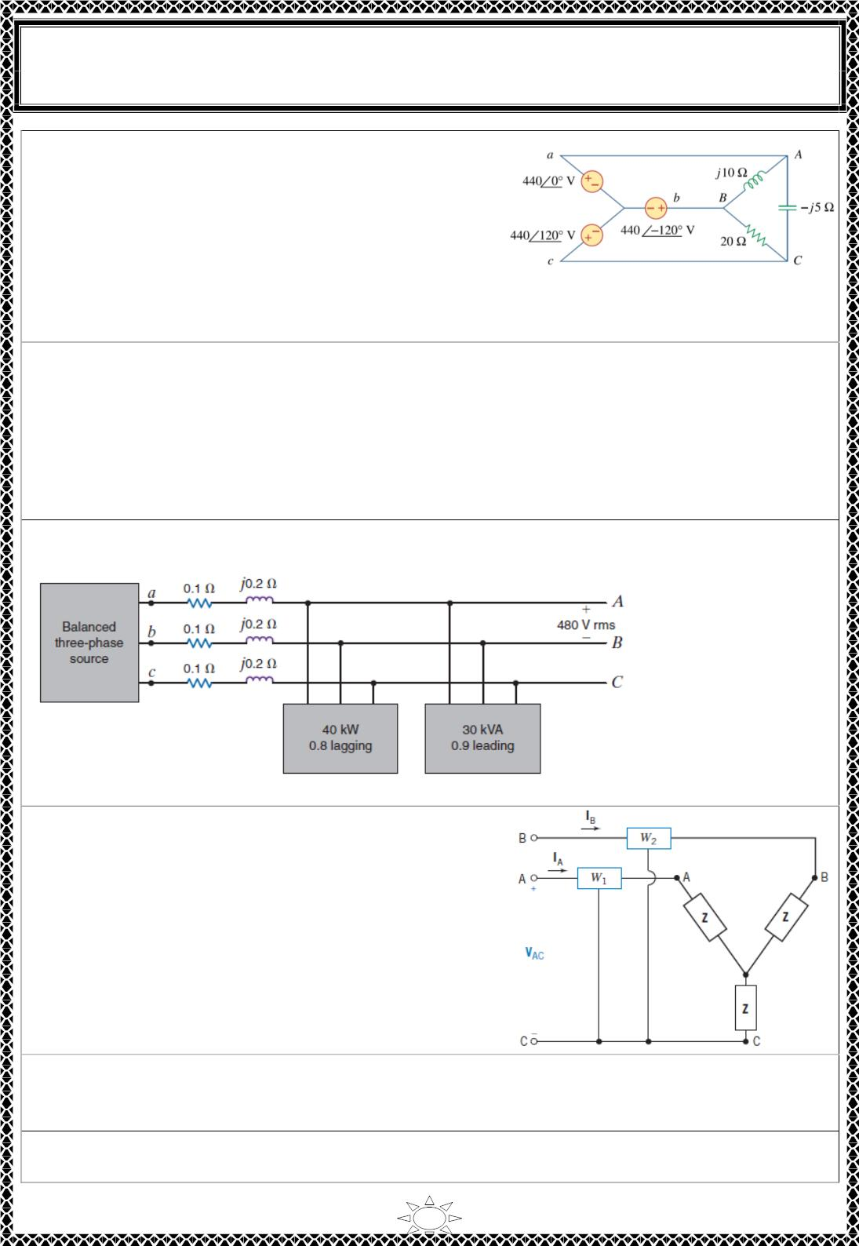
University of Diyala
Engineering College
Electronic Department
Electrical Circuits
2nd Class
Lecturer : Wisam N. AL-Obaidi
Year (2015-2016)
H.W.(31): Refer to Figure. Calculate:
(a) the line currents
(b) the real power absorbed by the load
(c) the total complex power supplied by the source
[Answer: (a) I = 132∠ퟑퟎ A, I = 47.23∠ퟏퟒퟑ ∙ ퟖ^{ퟎ}
a
ퟎ
b
A, Ic = 120.9∠ퟐퟑퟎ ∙ ퟗퟎ A (b) SAB =
j58.08 kVA, S = 29.04 kVA, S = - j116.16 kVA (c) S = 29.04 – j58.08 kVA]
BC
CA
T
H.W.(32): A balanced three-phase source serves three loads, as follows:
Load 1: 24 kW at 0.6 lagging power factor
Load 2: 10 kW at unity power factor
Load 3: 12 kVA at 0.8 leading power factor
If the line voltage at the loads is 208 V rms at 60 Hz, determine the line current and the
combined power factor of the loads.
[Answer: IL = 139.23 A rms, pfload =0.869 lagging]
H.W.(33): If the line voltage at the load is 480 V rms in Figure, find the line voltage and
power factor at the source.
Trail Version
Trail Version
Trail Version
Trail Version
Trail Version
Trail Version
Trail Version
Trail Version
Trail Version
Trail Version
Trail Version
Trail Version
Trail Version
[Answer: VL = 501.7 V rms, pfload =0.9568 lagging]
H.W.(34): The two-wattmeter method is used, as
shown in Figure, to measure the total power
delivered to the Y-connected load when Z =
10∠45⁰ V and the supply line-to-line voltage is 220
V rms. Determine the reading of each wattmeter
and the total power.
[Answer: p = 2698W, p = 723 W, P = P + P =
3421W]
1
2
1
2
H.W.(35): The two wattmeters in previous H.W. read P = 60 kW and P = 180 W,
1
2
respectively. Find the power factor of the circuit.
[Answer: pf = 0.756 lagging]
H.W.(36): The two-wattmeter method is used to determine the power drawn by a three-
phase 440-V rms motor that is a Y-connected balanced load. The motor operates at 20 hp
6

Slide 4
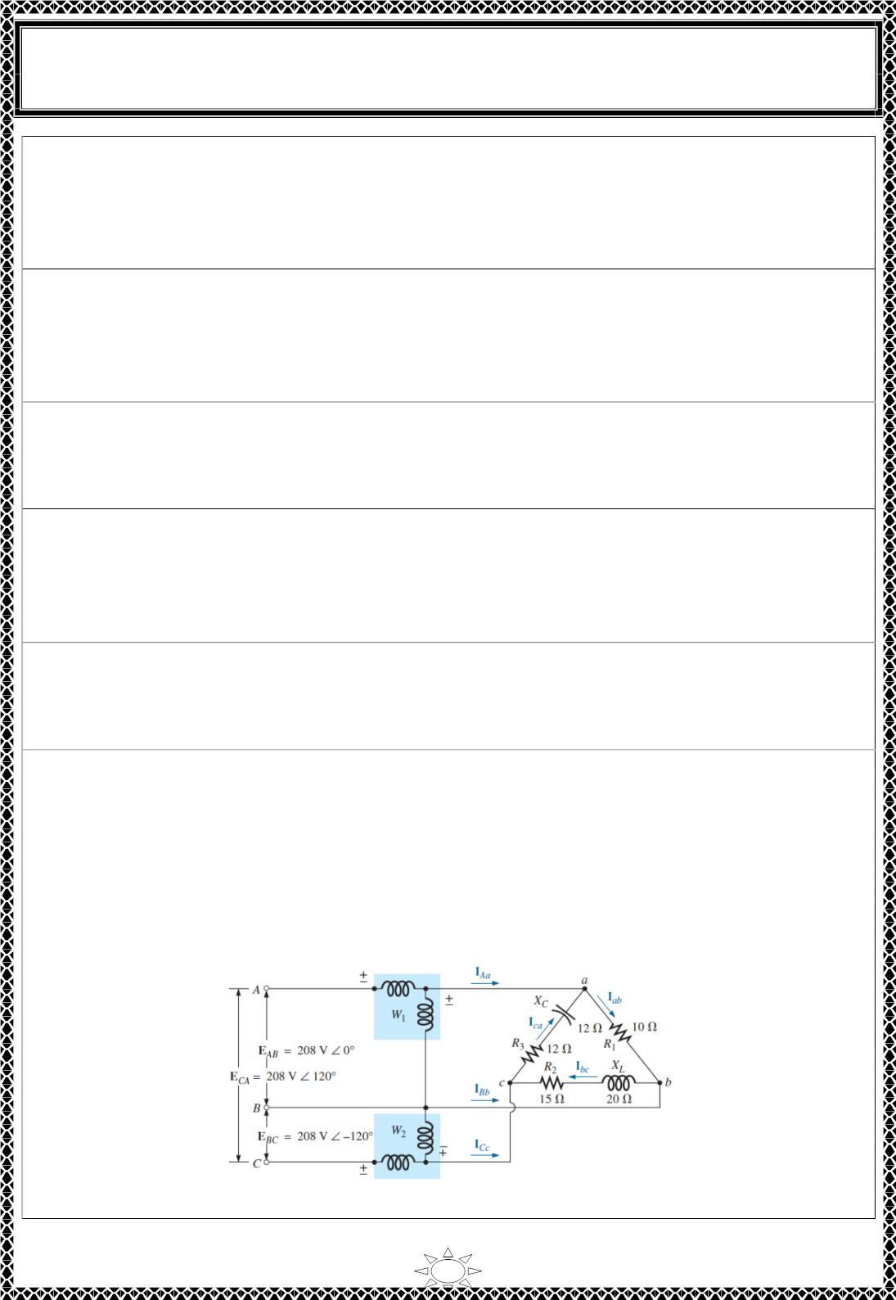
University of Diyala
Engineering College
Electronic Department
Electrical Circuits
2nd Class
Lecturer : Wisam N. AL-Obaidi
Year (2015-2016)
at 74.6
percent efficiency. The magnitude of the line current is 52.5 A rms. The wattmeters are
connected in the A and C lines. Find the reading of each wattmeter. The motor has a
lagging power factor.
[Answer: ]
H.W.(37): A three-phase system has a line-to-line voltage of 4000 V rms and a balanced
∆ -connected load with Z = 40 + j30 V. The phase sequence is abc. Use the two wattmeters
connected to lines A and C, with line B as the common line for the voltage measurement.
Determine the total power measurement recorded by the wattmeters.
[Answer: P = 768 kW]
H.W.(38): A three-phase system with a sequence abc and a line-to-line voltage of 200 V
rms feeds a Y-connected load with Z = 70.7∠45⁰ V. Find the line currents. Find the total
power by using two wattmeters connected to lines B and C.
[Answer: P = 400W]
H.W.(39): A three-phase system with a line-to-line voltage of 208 V rms and phase
sequence abc is connected to a Y-balanced load with impedance 10∠ −30⁰ Ω and a
balanced ∆ load with impedance 15∠30⁰ Ω. Find the line currents and the total power
using two wattmeters.
Trail Version
Trail Version
Trail Version
Trail Version
Trail Version
Trail Version
Trail Version
Trail Version
Trail Version
Trail Version
Trail Version
Trail Version
Trail Version
[Answer: ]
H.W.(40): The two-wattmeter method is used. The wattmeter in line A reads 920 W, and
the wattmeter in line C reads 460 W. Find the impedance of the balanced ∆-connected
load. The circuit is a three-phase 120-V rms system with an abc sequence.
[Answer: Z∆ = 27.1∠30⁰_ Ω]
H.W.(41): For the unbalanced ∆-connected load in Fig. with two properly connected
wattmeters.
a. Determine the magnitude and angle of the phase currents.
b. Calculate the magnitude and angle of the line currents.
c. Determine the power reading of each wattmeter.
d. Calculate the total power absorbed by the load.
e. Compare the result of part (d) with the total power calculated using
the phase currents and the resistive elements.
[Answer: (a) Iab = 20.8 ∠0° A, Ibc = 8.32 ∠ − ퟏퟕퟑ ∙ ퟏퟑ^{ퟎ} A, Ica = 12.26
∠165° A
7

Slide 5
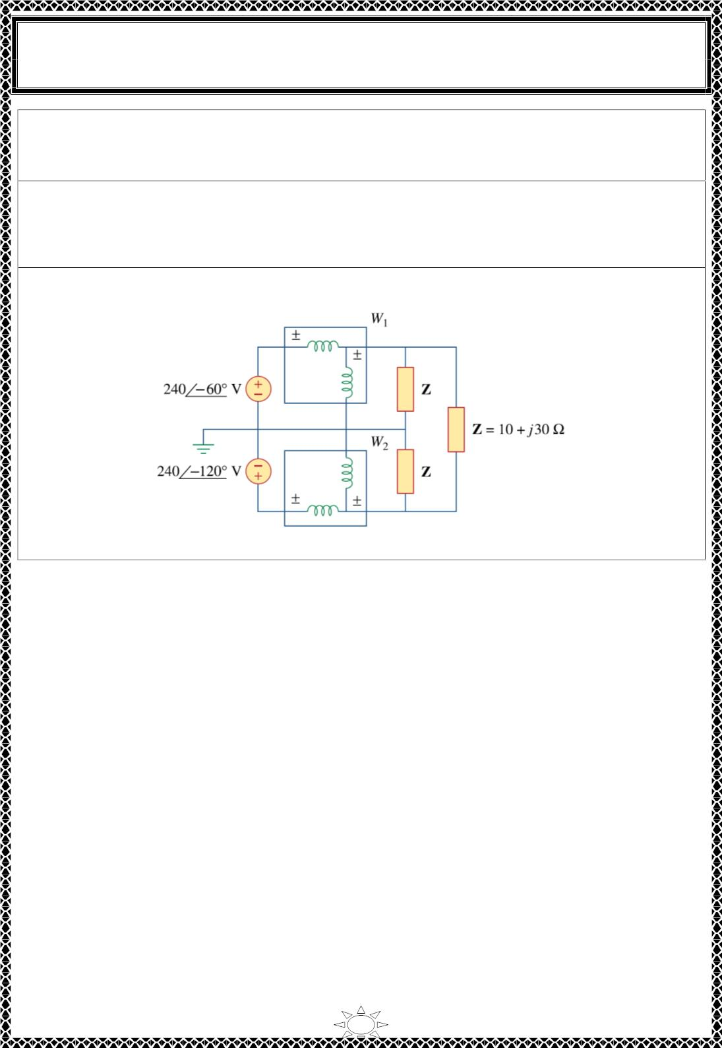
University of Diyala
Engineering College
Electronic Department
Electrical Circuits
2nd Class
Lecturer : Wisam N. AL-Obaidi
Year (2015-2016)
(b) Ia = 32.79 ∠-5.55° A, Ib = 29.08 ∠ − ퟏퟕퟖ ∙ ퟎퟑ^{ퟎ} A, Ic = 5.5
∠130.65° A
(c)P = 6788.35 W, P = 379.1 W (d) P = 7167.45 W (e) P = 7168.43 W (The slight
1
2
T
T
difference is due to the level of accuracy carried through the calculations.)]
H.W.(42): The two-wattmeter method gives P = 1200 W and P = –400 W for a three-
1
2
phase motor running on a 240-V line. Assume that the motor load is wye-connected and
that it draws a line current of 6 A. Calculate the pf of the motor and its phase impedance.
[Answer: pf = 0.4472 (leading), Zp = 40∠ − ퟔퟑ ∙ ퟒퟑ^{ퟎΩ}
]
H.W.(43): For the circuit displayed in Fig., find the wattmeter readings.
Trail Version
Trail Version
Trail Version
Trail Version
Trail Version
Trail Version
Trail Version
Trail Version
Trail Version
Trail Version
Trail Version
Trail Version
Trail Version
[Answer: p = 2360 W, p = -632.8 W]
1
2
8

Slide 6
Trail Version
Trail Version
Trail Version
Trail Version
Trail Version
Trail Version
Trail Version
Trail Version
Trail Version
Trail Version
Trail Version
Trail Version
Trail Version

Slide 7
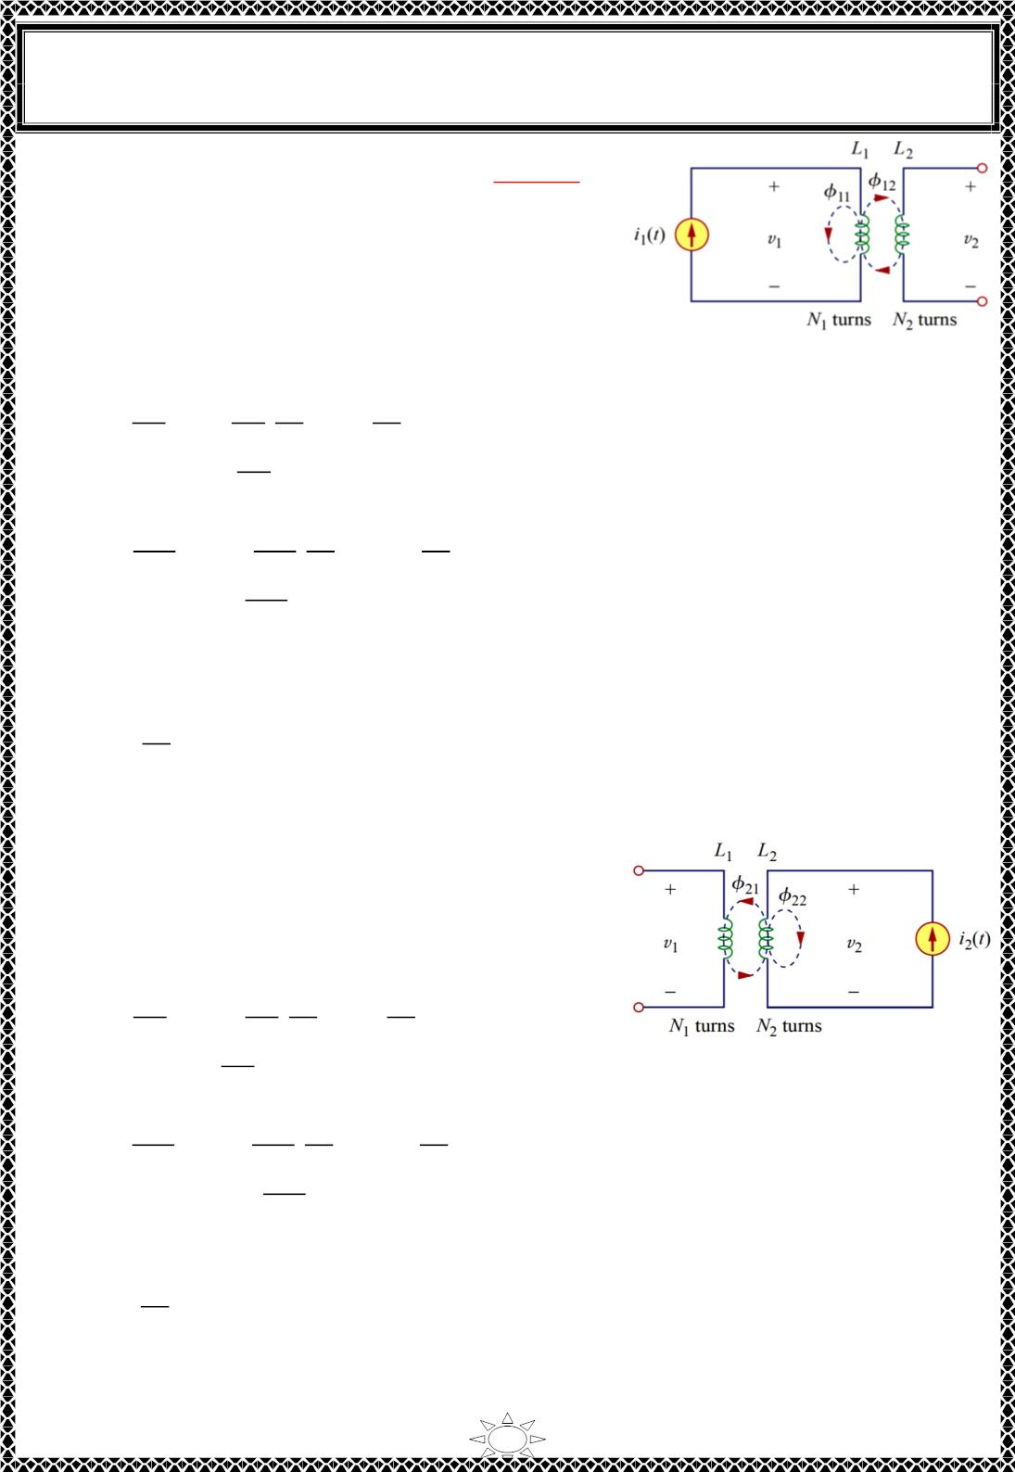
University of Diyala
Engineering College
Electronic Department
Electrical Circuits
2nd Class
Lecturer : Wisam N. AL-Obaidi
Year (2015-2016)
2.2) Two coils with self-inductances L and L :
1
2
Consider Fig.2.2, For simplicity, assume that the
second inductor carries no current. The magnetic flux
∅ emanating from coil 1 has two components:
ퟏ
1) component ∅ links only coil 1
ퟏퟏ
2) component ∅ links both coils.
ퟏퟐ
∴ ∅_{ퟏ} = ∅_{ퟏퟏ} + ∅_{ퟏퟐ}
Since the entire flux ∅ links coil 1, so
...(2.4)
Fig.2.2
^{푑∅}ꢀ
dt
ퟏ
푣₁ = 푁
= 푁
^{푑∅}ꢀ ^{푑푖}ꢀ
^{푑푖}ꢀ
dt
1
1
푑푖 dt
= 퐿₁
...(2.5)
ꢀ
푑∅
Where 퐿₁ = 푁
ꢀ
is the self inductance of coil 1.
1
푑푖
ꢀ
Only flux ∅ links coil 2, so
ퟏퟐ
푣₂ = 푁₂
^{푑∅}ꢀꢁ
= 푁₂
^{푑∅}ꢀꢁ ^{푑푖}ꢀ
^{푑푖}ꢀ
dt
dt
푑푖ꢀ dt
= 푀₂₁
...(2.6)
...(2.7)
푑∅
Where 푀₂₁ = 푁₂
ꢀꢁ
푑푖
ꢀ
푀 is known as the mutual inductance of coil 2 with respect to coil 1. Subscript 21 indicates
21
that the inductance 푀 relates the voltage induced in coil 2 to the current in coil 1. Thus,
Trail Version
Trail Version
Trail Version
Trail Version
Trail Version
Trail Version
Trail Version
Trail Version
Trail Version
Trail Version
Trail Version
Trail Version
Trail Version
12
the open-circuit mutual voltage (or induced voltage) across coil 2 is
^{푑푖}ꢀ
dt
푣₂ = 푀₂₁
...(2.8)
2.3) Suppose we now let current i2 flow in coil 2, while coil 1 carries no current:
Consider Fig. 3, the magnetic flux ∅ emanating from
ퟐ
coil 2 comprises flux ∅ that links only coil 2 and
ퟐퟐ
flux ∅ that links both coils.
ퟐퟏ
∴ ∅ = ∅ + ∅_{ퟐퟐ}
...(2.9)
ퟐ
ퟐퟏ
The entire flux ∅ links coil 2, so
푣₂ = 푁₂
^{푑∅}ꢁ
푑푡
ퟐ
^{푑∅}ꢁ ^{푑푖}ꢁ
푑푖ꢁ dt
^{푑푖}ꢁ
dt
= 푁₂
= 퐿₂
...(2.10)
^{푑∅}ꢁ
Where 퐿₂ = 푁₂
is the self inductance of coil 2.
Fig.2.3
푑푖
ꢁ
Only flux ∅ links coil 1. so
ퟐퟏ
푣₁ = 푁
^{푑∅}ꢁꢀ
= 푁
^{푑∅}ꢁꢀ ^{푑푖}ꢁ
^{푑푖}ꢁ
dt
1
푑푡
1
푑푖
dt
= 푀₁₂
...(2.11)
...(2.12)
ꢁ
푑∅
Where
푀₁₂ = 푁
ꢁꢀ
1
푑푖ꢁ
which is the mutual inductance of coil 1 with respect to coil 2. Thus, the open-circuit mutual
voltage across coil 1 is
푣 = 푀
^{푑푖}ꢁ
dt
...(2.13)
...(2.14)
1
12
푀 = 푀 = 푀
12
21
2

Slide 8
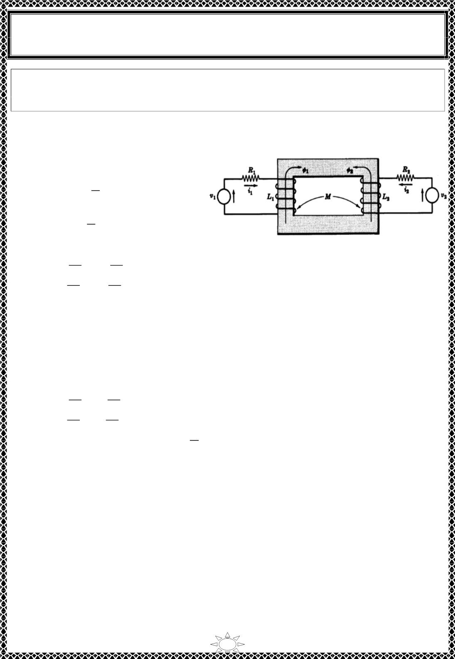
University of Diyala
Engineering College
Electronic Department
Electrical Circuits
2nd Class
Lecturer : Wisam N. AL-Obaidi
Year (2015-2016)
Mutual inductance is the ability of one inductor to induce a voltage across a neighboring
inductor, measured in henrys (H). Like self-inductance L, mutual inductance M is
measured in henrys (H).
3)ANALYSIS OF COUPLED CIRCUITS
Although mutual inductance M is
always a positive quantity, the mutual
푑푖
voltage (푣 = 푀 ) may be negative or
dt
positive, just like the self induced
푑푖
voltage (푣 = 퐿 ).
dt
For Fig.3.1 . apply Kirchhoff's voltage law (KVL),
Fig.3.1
^{푑푖}ꢁ
^{푑푖}2
푅 ꢀ + 퐿₁
∓ 푀
∓ 푀
= 푣₁
…(3.1)
…(3.2)
1 1
푑푡
푑푡
푑푖
푑푖
푅 ꢀ + 퐿_{ꢂ}
ꢂ ꢂ
2
ꢁ
= 푣_{ꢂ}
푑푡
푑푡
To determine the correct signs in Eqs(3.1) and (3.2) apply the right hand rule to each coil,
allowing the fingers to wrap around in the direction of the assumed current. Then the right
thumb points in the direction of the flux. Thus the positive directions of ∅ , and ∅ are as
Trail Version
Trail Version
Trail Version
Trail Version
Trail Version
Trail Version
Trail Version
Trail Version
Trail Version
Trail Version
Trail Version
Trail Version
Trail Version
ퟏ
ퟐ
shown in the figure. If fluxes ∅ and ∅ due to the assumed positive current directions aid one
ퟏ
ퟐ
another, then the signs on the voltages of mutual inductance are the same as the signs on the voltages of
self-inductance.
So Eqs(3.1) and (3.2) becomes
^{푑푖}ꢁ
^{푑푖}2
푅 ꢀ + 퐿₁
− 푀
− 푀
= 푣₁
= 푣_{ꢂ}
…(3.3)
…(3.4)
1 1
푑푡
푑푡
푑푖
푑푖
푅 ꢀ + 퐿_{ꢂ}
ꢂ ꢂ
2
ꢁ
푑푡
푑푡
풅
In frequency domain (replacing each 푏푦 풋흎)Eqs(3.3) and (3.4) becomes,
( 푅 + 푗휔퐿 )퐼 − 푗휔푀퐼 = V
풅풕
1
1
1
ꢂ
1
→ Z I + Z I = V
1
…(3.5)
…(3.6)
11 1
1ꢂ ꢂ
−푗휔푀퐼 + ( 푅 + 푗휔퐿 )퐼 = V → Z I + Z I = V
1
ꢂ
ꢂ
ꢂ
ꢂ
ꢂ1 1
ꢂꢂ ꢂ
ꢂ
Where Z = 푅 + 푗휔퐿 , Z = 푅 + 푗휔퐿 , and Z = Z = −푗휔푀 which is common to
the two mesh currents I
11
1
1
22
ꢂ
ꢂ
12
21
I
1 and 2.
4) NATURAL CURRENT
In Fig.4.1 . select current I in agreement with the source V and apply the right hand rule
1
1
to determine the direction of the flux ∅_{ퟏퟐ}. Now Lenz's law states that the polarity of the
induced voltage is such that if the circuit is completed, a current will pass through the coil in a direction
which creates a flux opposing the main flux set up by current I1. Therefore when the switch is
closed in the circuit of Fig.5, the direction of flux ∅_{ퟐퟏ} according to Lenz's law is as shown.
Now apply the right hand rule with the thumb pointing in the direction of the fingers will
3

Slide 9
Trail Version
Trail Version
Trail Version
Trail Version
Trail Version
Trail Version
Trail Version
Trail Version
Trail Version
Trail Version
Trail Version
Trail Version
Trail Version

Slide 10
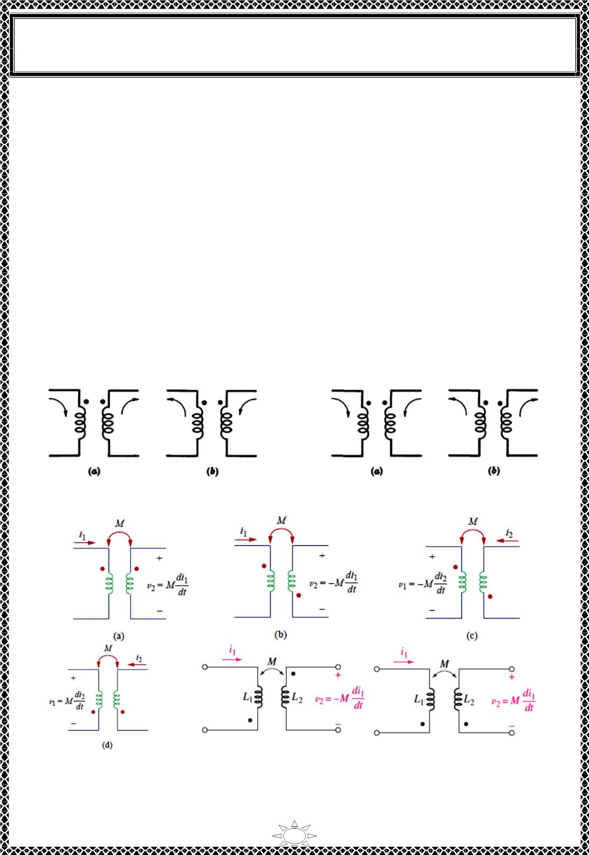
University of Diyala
Engineering College
Electronic Department
Electrical Circuits
2nd Class
Lecturer : Wisam N. AL-Obaidi
Year (2015-2016)
To determine the sign of the voltage of mutual inductance in the mesh current equations,
we use the dot rule which states:
1) When both assumed currents enter or leave a pair of coupled coils at the dotted terminals, the
signs of the M terms will be the same as the signs of the L terms;
2) If one current enters at a dotted terminal and one leaves by a dotted terminal, the signs of the M
terms are opposite to the signs of the L terms.
or
3) If a current enters the dotted terminal of one coil, the reference polarity of the mutual voltage in
the second coil is positive at the dotted terminal of the second coil.
4) If a current leaves the dotted terminal of one coil, the reference polarity of the mutual voltage in
the second coil is negative at the dotted terminal of the second coil.
Thus, the reference polarity of the mutual voltage depends on the reference direction of the
inducing current and the dots on the coupled coils.
Fig.5.2 shows when the signs of the M and L terms are opposite. Fig.5.3 shows two cases
in which the signs of M and L are the same.
Trail Version
Trail Version
Trail Version
Trail Version
Trail Version
Trail Version
Trail Version
Trail Version
Trail Version
Trail Version
Trail Version
Trail Version
Trail Version
Fig.5.2
Fig.5.3
(e)
(f)
Fig.5.4 Examples illustrating how to apply the dot convention
5

